Slide 1
C Programming Language Introduction
Michael Rutalo

Slide 2
1.1 Introduction
We will learn
The C programming language
Structured programming and proper programming techniques
This course is appropriate for
Technically oriented people with little or no programming experience
Experienced programmers who want a deep and rigorous treatment of the language

Slide 3
1.2 History of C
C
Evolved by Ritchie from two previous programming languages, BCPL and B
Used to develop UNIX
Used to write modern operating systems
Hardware independent (portable)
By late 1970's C had evolved to "Traditional C"
Standardization
Many slight variations of C existed, and were incompatible
Committee formed to create a "unambiguous, machine-independent" definition
Standard created in 1989, updated in 1999

Slide 4
Portability
Because C is a hardware-independent, widely available language, applications written in C can run with little or no modifications on a wide range of different computer systems.

Slide 5
1.10 C++
C++
Superset of C developed by Bjarne Stroustrup at Bell Labs
"Spruces up" C, and provides object-oriented capabilities
Dominant language in industry and academia
Learning C++
Because C++ includes C, some feel it is best to master C, then learn C++
Starting in Chapter 18, we begin our introduction to C++

Slide 6
Common Programming Error
Errors like division-by-zero occur as a program runs, so these errors are called runtime errors or execution-time errors. Divide-by-zero is generally a fatal error, i.e., an error that causes the program to terminate immediately without successfully performing its job. Nonfatal errors allow programs to run to completion, often producing incorrect results.

Slide 7
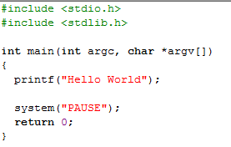
Simple first program: Hello World

Slide 8
First Program: Hello world
#include directive tells C to load a particular file
Left brace declares beginning of main function
Statements tells C to perform an action. Must end with ;
return statement ends the function
Right brace declares end of main function

Slide 9
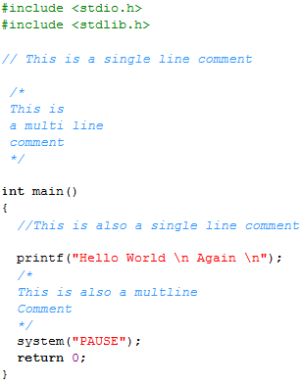

Adding Comments

Slide 10
Description of Program
Comments
Text surrounded by /* and */ is ignored by computer
A Single line beginning with // is also ignored by computer
Used to describe program
#include <stdio.h>
Preprocessor directive
Tells computer to load contents of a certain file
<stdio.h> allows standard input/output operations

Slide 11
Common Programming Error 2.1
Forgetting to terminate a comment with */.

Slide 12
Common Programming Error 2.2
Starting a comment with the characters */ or ending a comment with the characters /*.

Slide 13
2.2 A Simple C Program: Printing a Line of Text
int main()
C programs contain one or more functions, exactly one of which must be main
Parenthesis used to indicate a function
int means that main "returns" an integer value
Braces ({ and }) indicate a block
The bodies of all functions must be contained in braces

Slide 14
2.2 A Simple C Program: Printing a Line of Text
printf( "Welcome to C!\n" );
Instructs computer to perform an action
Specifically, prints the string of characters within quotes (" ")
Entire line called a statement
All statements must end with a semicolon (;)
Escape character (\)
Indicates that printf should do something out of the ordinary
\n is the newline character

Slide 15
Fig. 2.2 | Some common escape sequences.

Slide 16
Common Programming Error 2.3
Typing the name of the output function printf as print in a program.

Slide 17
2.2 A Simple C Program: Printing a Line of Text
return 0;
A way to exit a function
return 0, in this case, means that the program terminated normally
Right brace }
Indicates end of main has been reached
Linker
When a function is called, linker locates it in the library
Inserts it into object program
If function name is misspelled, the linker will produce an error because it will not be able to find function in the library

Slide 18
printf statement starts printing from where the last statement ended, so the text is printed on one line.

Slide 19
Newline characters move the cursor to the next line

